Slide 1
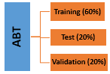
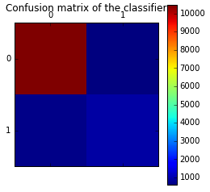
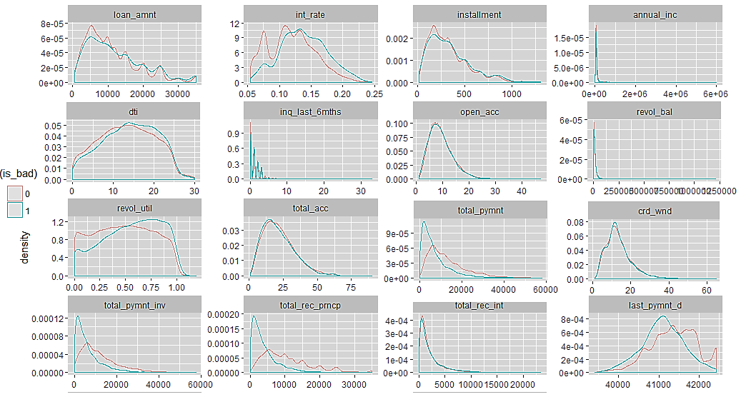
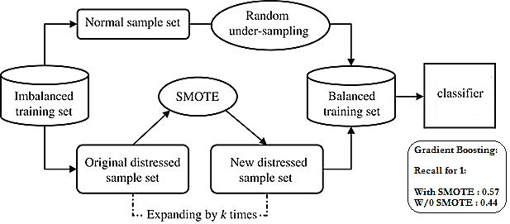
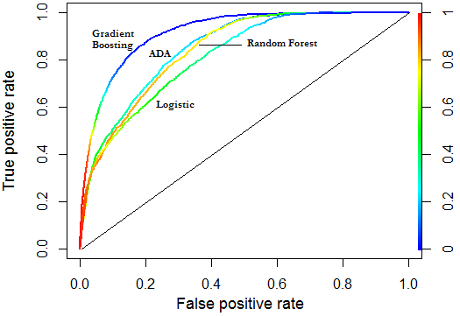
Logistic Regression
Random Forest
Ada Boost
Gradient Boost
Applicants’ Credit Risk Scoring – Jigar Mehta
Data Cleaning:
Feature reduction based on 60% & above missing data
Missing value treatment using MICE(PMM, poly reg)
Outlier treatment
Model Development:
Evaluation:
Business Objective : Classify the likelihood of customers being default or current after taking loan
Boosting and simple classifiers are used to train and performances were compared on validation data
Data import and merging
Imputation using MICE and Outlier correction
Binning and Standardization
# Row | 42,535
# Column | 111
# Default (1) | 5660 (13%)
# Current (0) | 36875 (87%)
Data:
Loans issued: 2007-2011
Process Flow:
Feature Selection
Variance Inflation factor (VIF)
Chi-Sq Tests
Feature Transformation
One hot encoding
Range Normalization
Label Encoder
Weight of Evidence (WOE)
Analytical Base Table
(ABT)
Business Need
Data Cleaning
Data Prep. (ABT)
Modeling
Evaluation
Data Preparation:
Classification Metrics (Test Dataset):
MICE
Outlier Treatment
Stochastic Gradient Boosting – Tuning Parms:
n_estimators = 100
Learning_rate=0.2
Subsample = 0.8
max_depth= 10
Min_samples_split=30
warm_start=True
Execution time = 7.1 mins
Probabilistic method
Boosting algorithm
Feature Selection
Classification Tree
SMOTE
Categorical: WOE, IV, Chi-Sq test
Numerical: VIF (Multi-collinearity)
Parameter Relative Importance (%)
Descriptive Analytics:
Tools : R, Python
Univariate Analysis
Synthetic Minority Over-Sampling Technique
ROC performance (Multiple models - Test Dataset)
Validation data Results:
Precision (for 1) | 0.59
Recall (for 1) | 0.56
SMOTE Output: Balanced Classification (50:50)

